Slide 1


iPredict
by MyProperty
Your one-stop portal to predict future house prices
Desmond, Ian, Richelle, Ridzuan
28 Sep 2022

Slide 2
Table of contents
01
02
Background
Data Cleaning
03
04
05
Modeling
Application
Conclusion
Where and what we are trying to solve
How we cleaned and prepared the data
Regression model to predict sale prices
Predictor
application
Summary and recommendations

Slide 3

01.
Background
Where and what we are trying to solve

Slide 4



Employee Personas
I literally spend 4 hours trying to come up with a price but my buyer is still not satisfied..
All I do is look through the properties listed online, but I’m still lost…
There are just way too many features to consider all the time…
Aileen
2 years experience
Susan
8 years experience
Matthew
10 years experience

Slide 5

Problem Statement
How to help realtors effectively and efficiently predict the market value of houses in Ames, Iowa?

Slide 6
2930 observations, 82 variables
Ames Housing Dataset (2006-2010)
Variables | Description | Responses
Exterior quality | Quality of the material on the exterior | Excellent Good Average/typical Fair Poor
Exterior condition | Present condition of the material on the exterior
Kitchen quality | Kitchen quality
Basement quality | Height of the basement | Excellent (100+ inches) Good (90-99 inches) Typical (80-89 inches) Fair (70-70 inches) Poor (<70 inches) NA (no basement)
Source: Ames, Iowa Assessor’s Office

Slide 7
Selected Features
Ridge model - 16 features selected
R2: 0.93 RMSE: 21072
Overall material and finish quality | Neighborhood
Exterior material quality | Overall condition rating
Above grade (ground) living area square feet | Lot size in square feet
Kitchen quality | Size of garage in car capacity
Screen porch area in square feet | Fireplace quality
Original construction date | Basement finished area
Proximity to main road or railroad | Home functionality rating
Total square feet of basement area | Height of basement

Slide 8

02.
Data Cleaning
How we cleaned and prepared the data

Slide 9
Our Cleaning Process
Multi-
collinearity
(numeric features)
Small variance (categorical variables)
Missing values
80% of the same responses (categoric features)

Slide 10
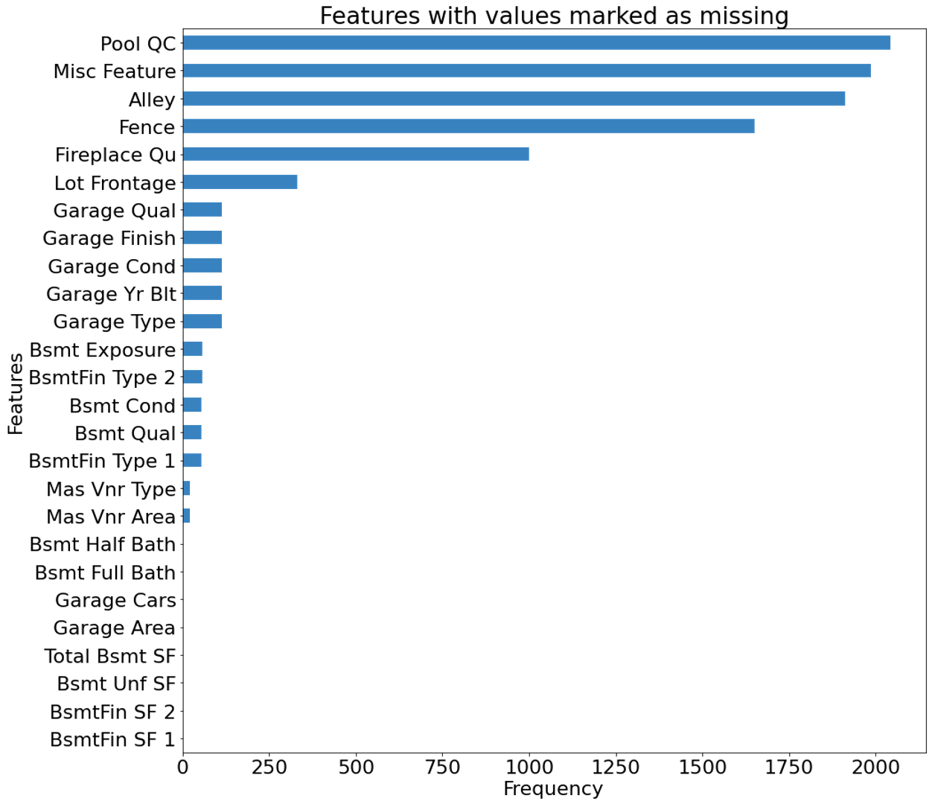
Columns with Missing Values
Columns with missing values
Missing values due to non-existent house features
Solution:
“0” to replace missing numeric variables
“None” to replace missing categorical variables
Mean/mode to replace remaining variables

Slide 11
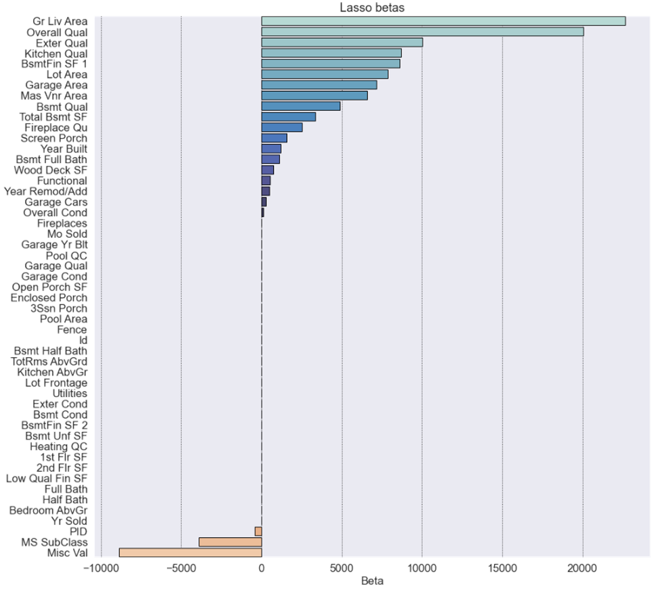
Numeric Feature Selection
Preprocessing features by Lasso
29 features were dropped with lasso beta of 0
These features had no impact to sale price prediction -> interfering noise with other model estimators (e.g., Linear Regression or Ridge)

Slide 12
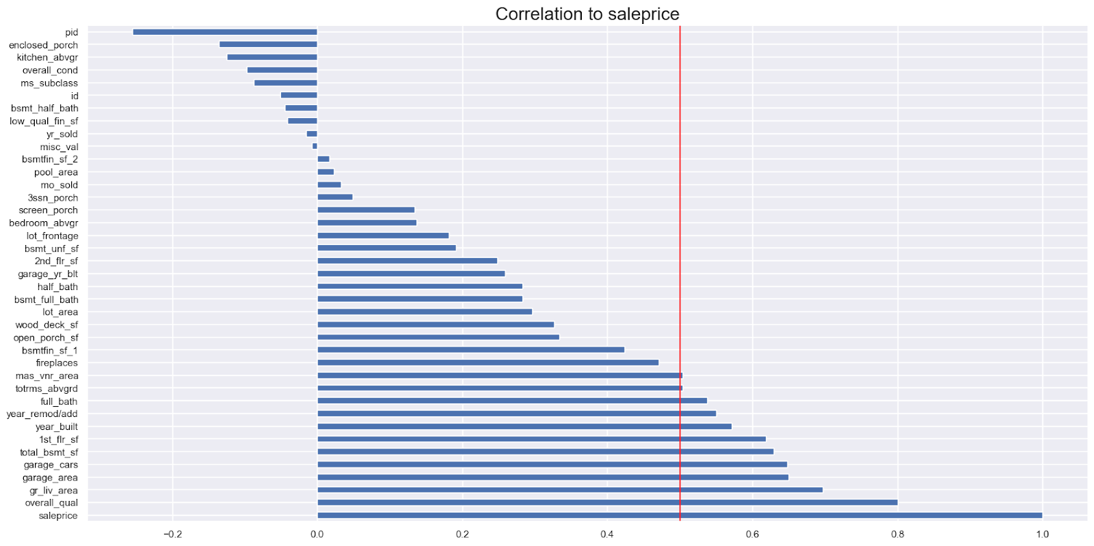
Numeric Feature Selection
Comparison with correlation between base numeric features and sale price
11 features with more than 0.5 positive correlation with sale price
No feature that had above -0.5 negative correlation with sale price

Slide 13
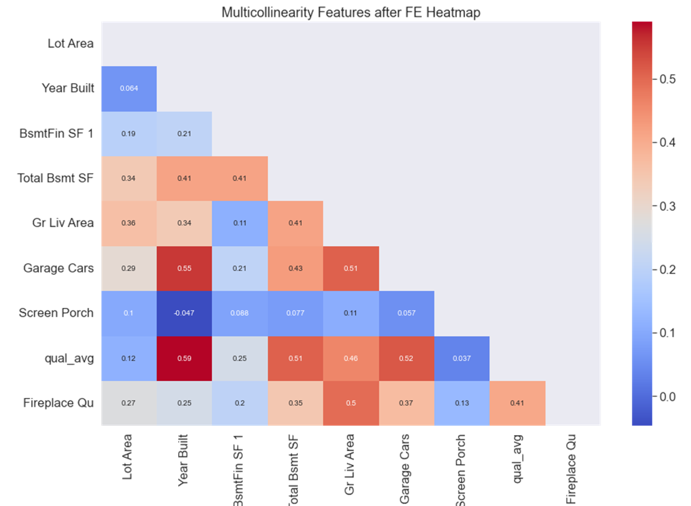
Numeric Feature Selection
Final selection
Utilised multicollinearity reduction
Lasso coefficient (betas)
Correlation between features only
Correlation between features and sale price
Feature engineering
Above grade (ground) living area square feet (gr_liv_area) was chosen over total rooms above ground as one of the features
Highest lasso beta
Above 0.5 correlation with sale price
High correlation with total rooms above ground
Feature engineering
6 features to make qual_average

Slide 14
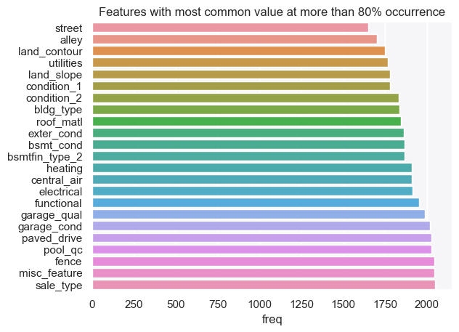
Categoric Feature Selection
More than 80% common value occurrence
These features were dropped and not considered for the the subsequent evaluations in the boxplots with sales price

Slide 15
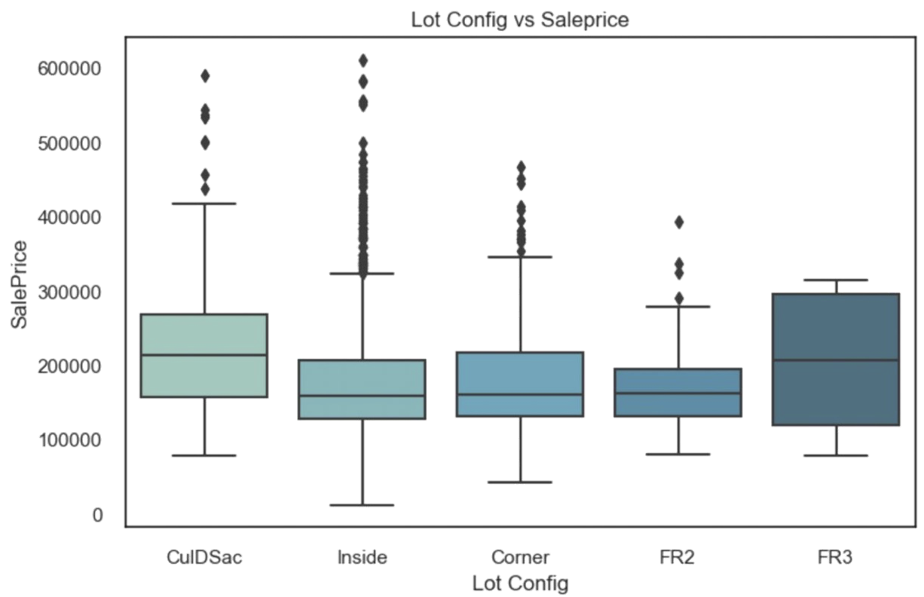
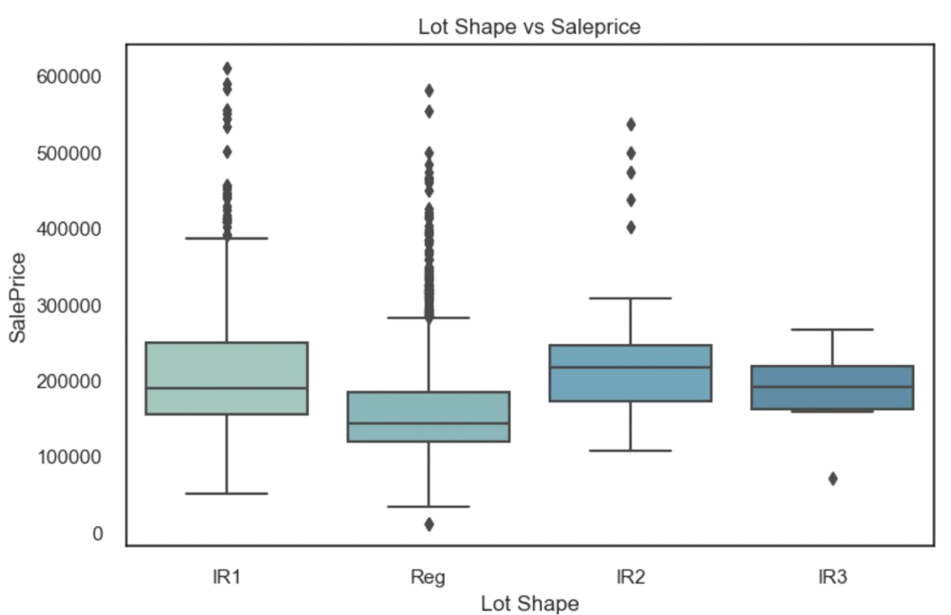
Small Variance among Variables
Most outliers: Inside and Corner Lot configurations
Most outliers: IR1 (slightly irregular) and Reg (regular)

Slide 16
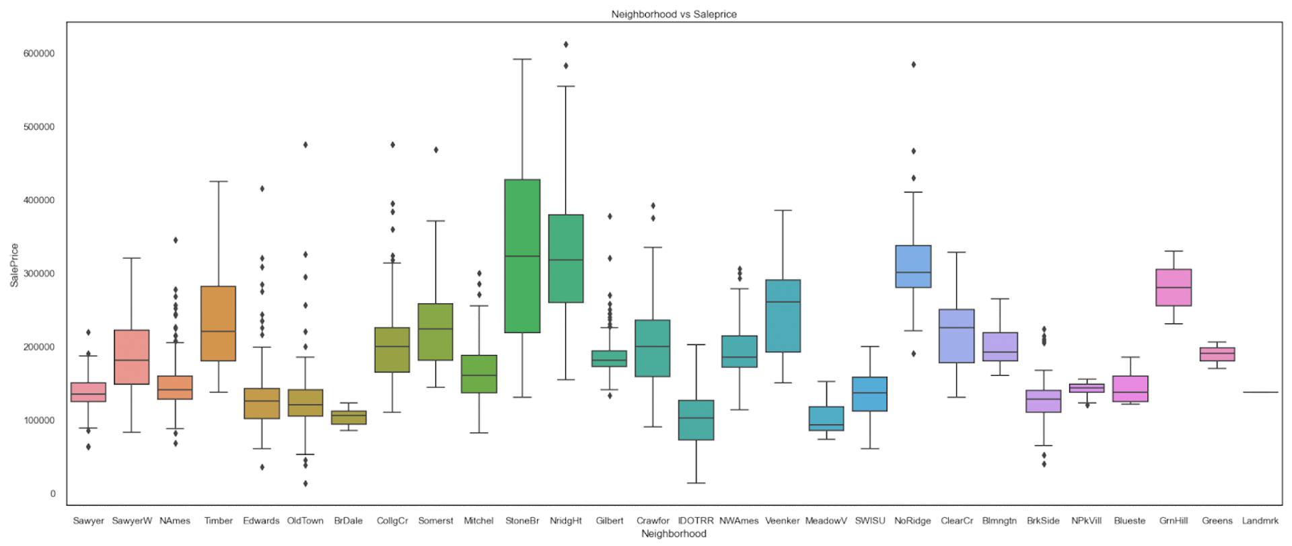
Boxplot of Neighborhoods with Sale Price
Neighborhoods with the highest median sale prices: Stone Brook and Northridge Heights
Neighborhoods with the lowest median sale prices: Meadow Village and Iowa DOT

Slide 17
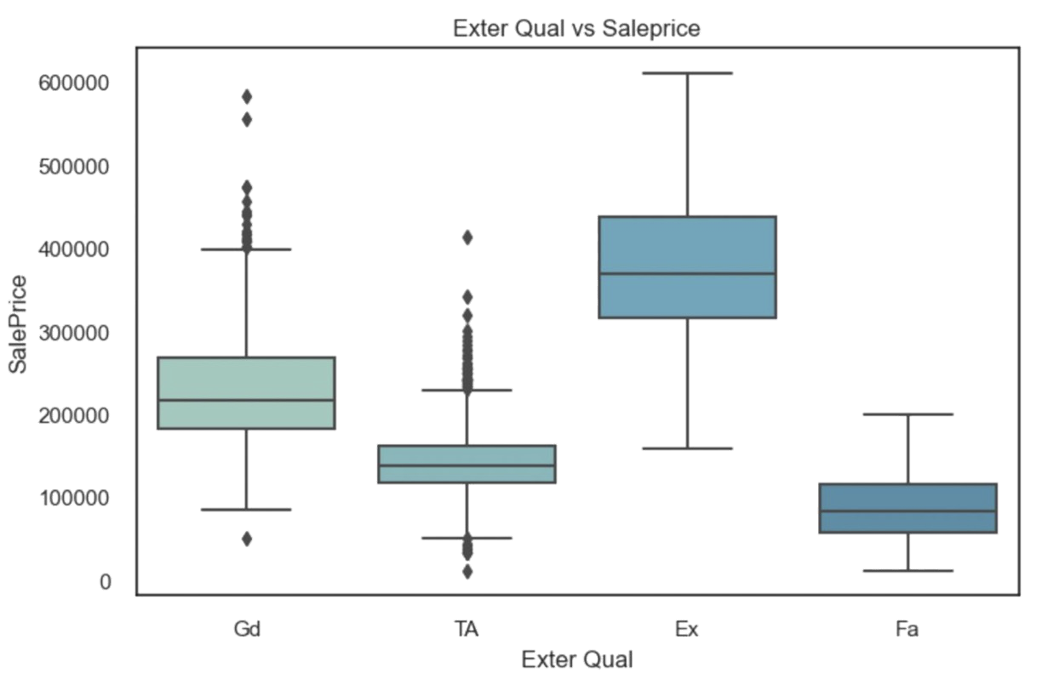
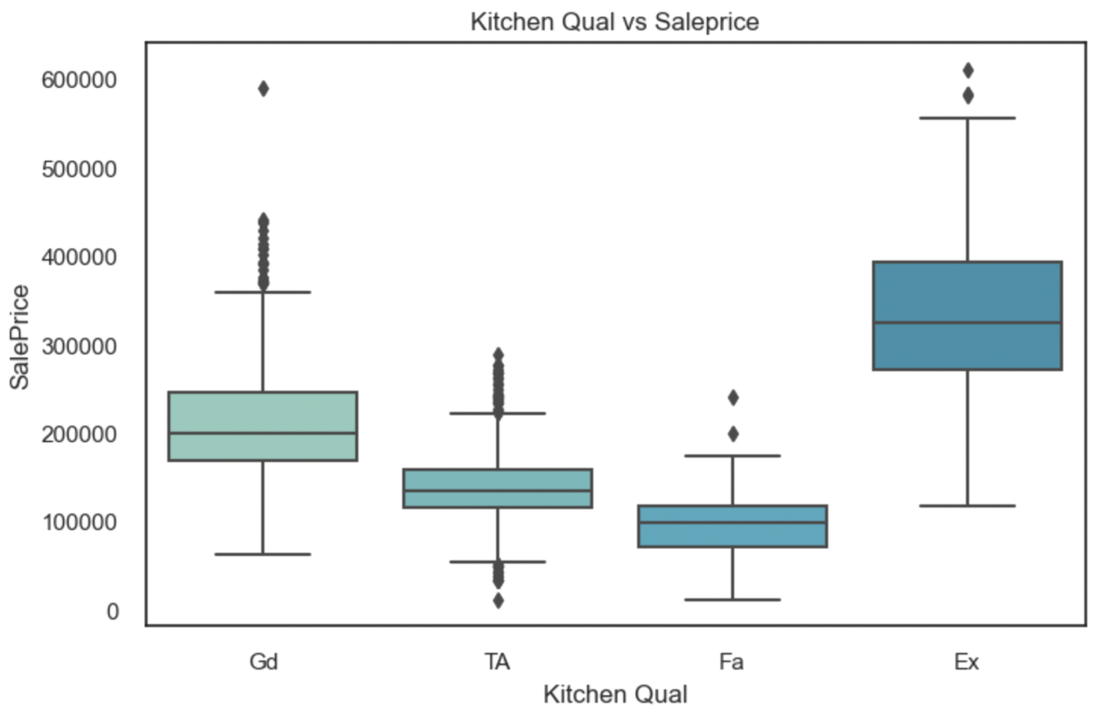
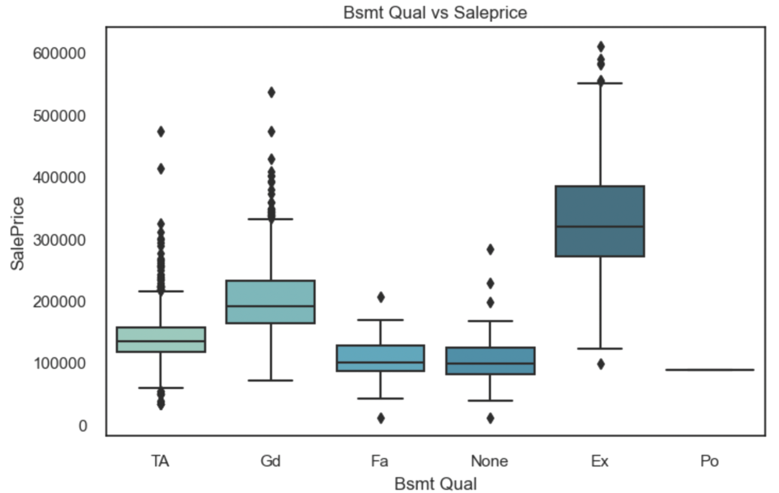
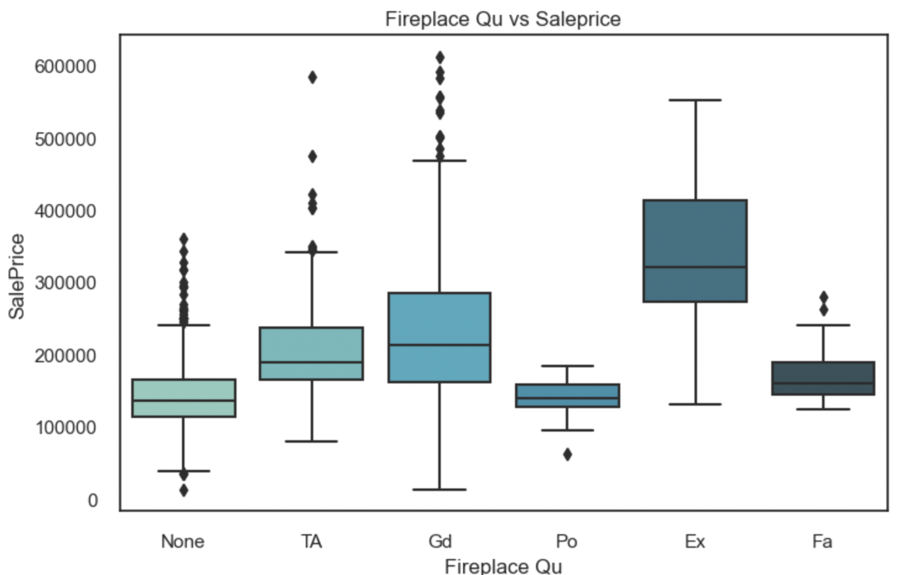
Boxplots of Various Features with Sale Price

Slide 18
03.
Model
Regression model to predict sale prices

Slide 19
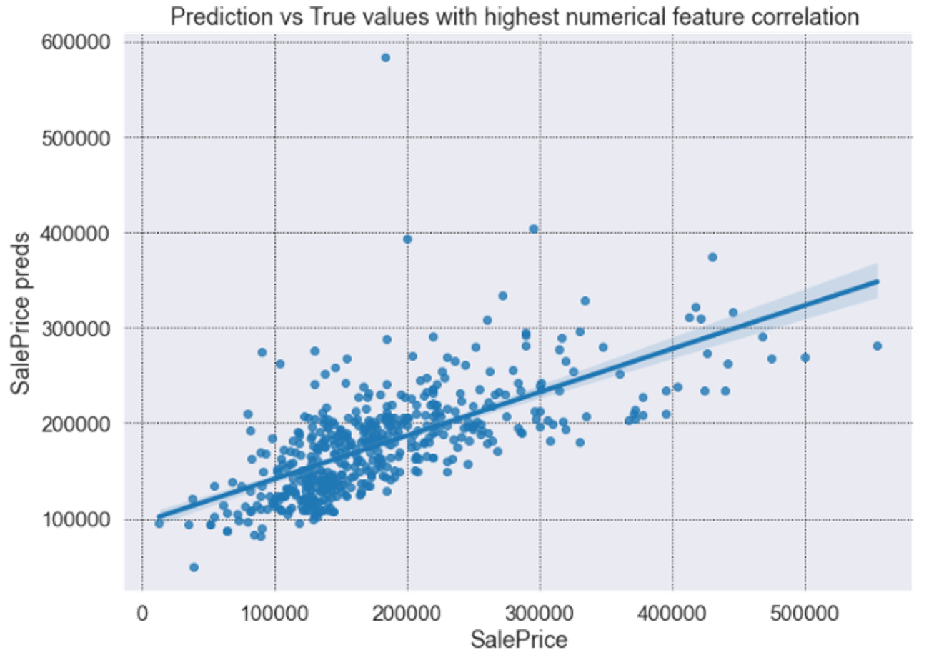
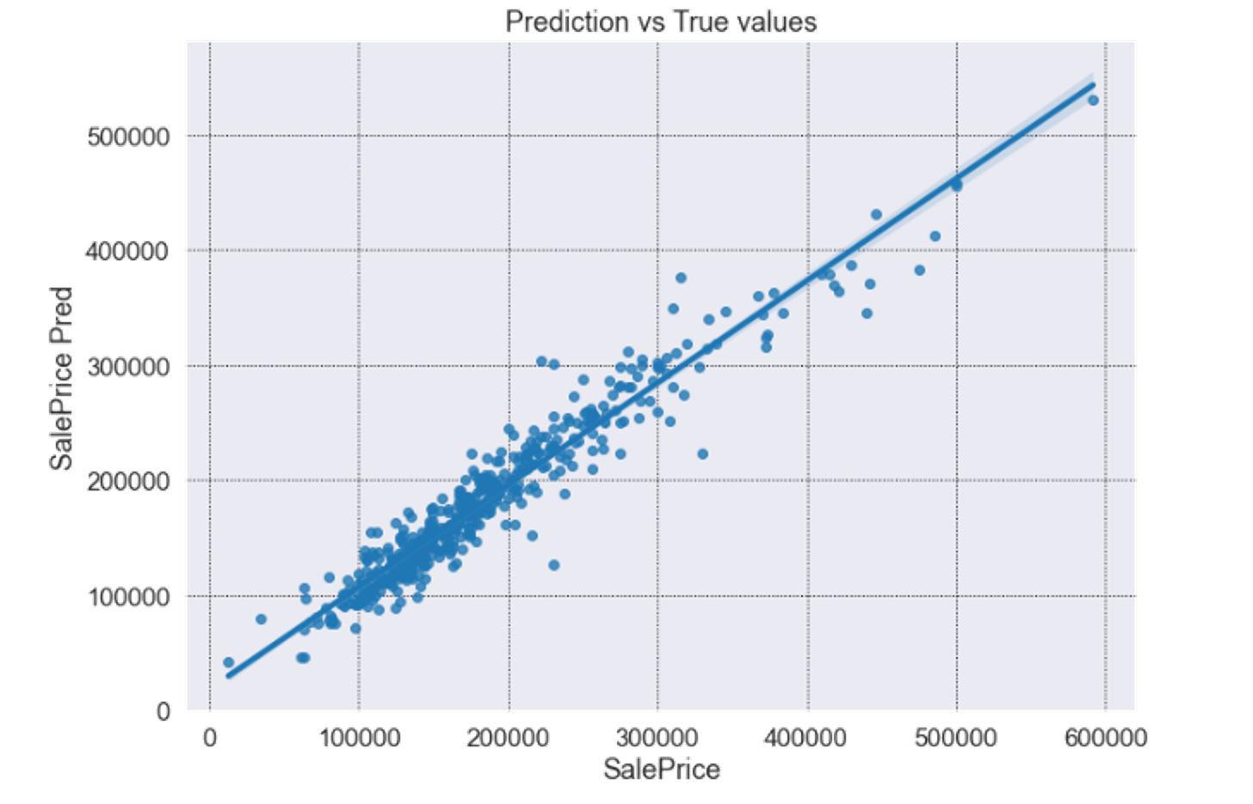
Baseline Model vs Final Best Model
R2: 0.44
RMSE: 59355
R2: 0.93
RMSE: 21072

Slide 20
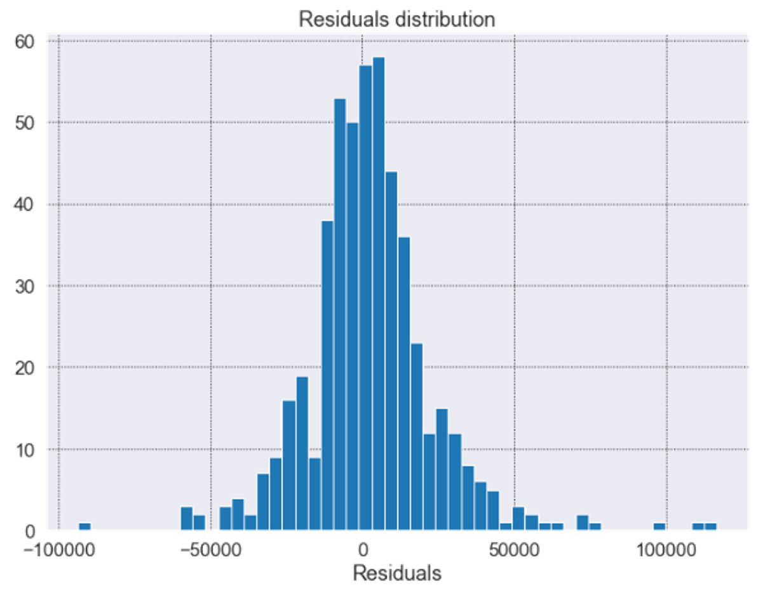
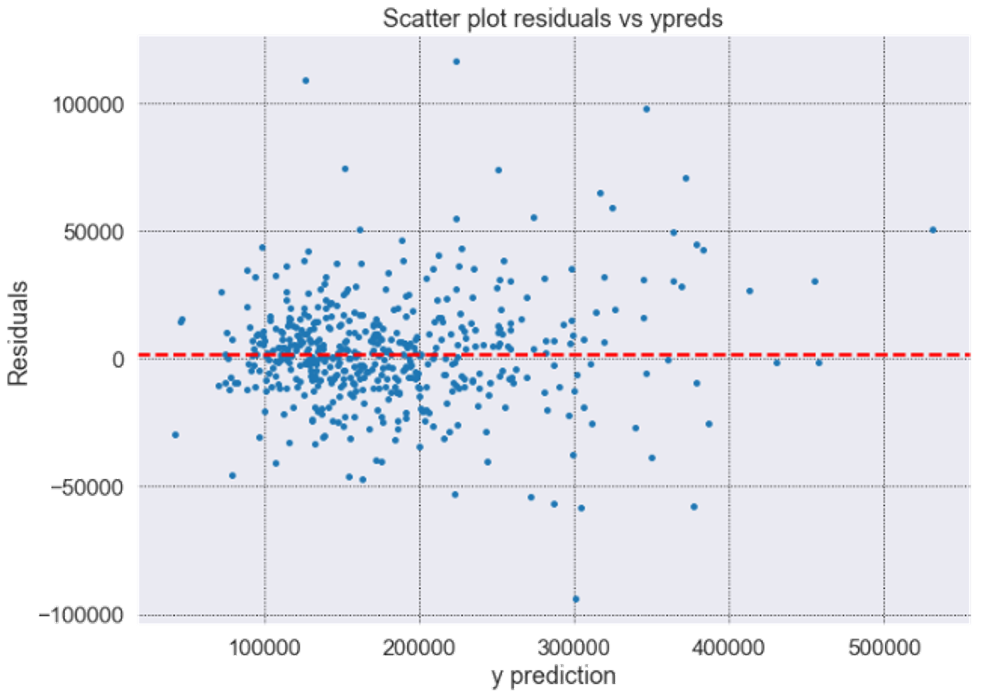
Residual Distribution and Average
Residual distribution is close to nominal and the average is near 0

Slide 21
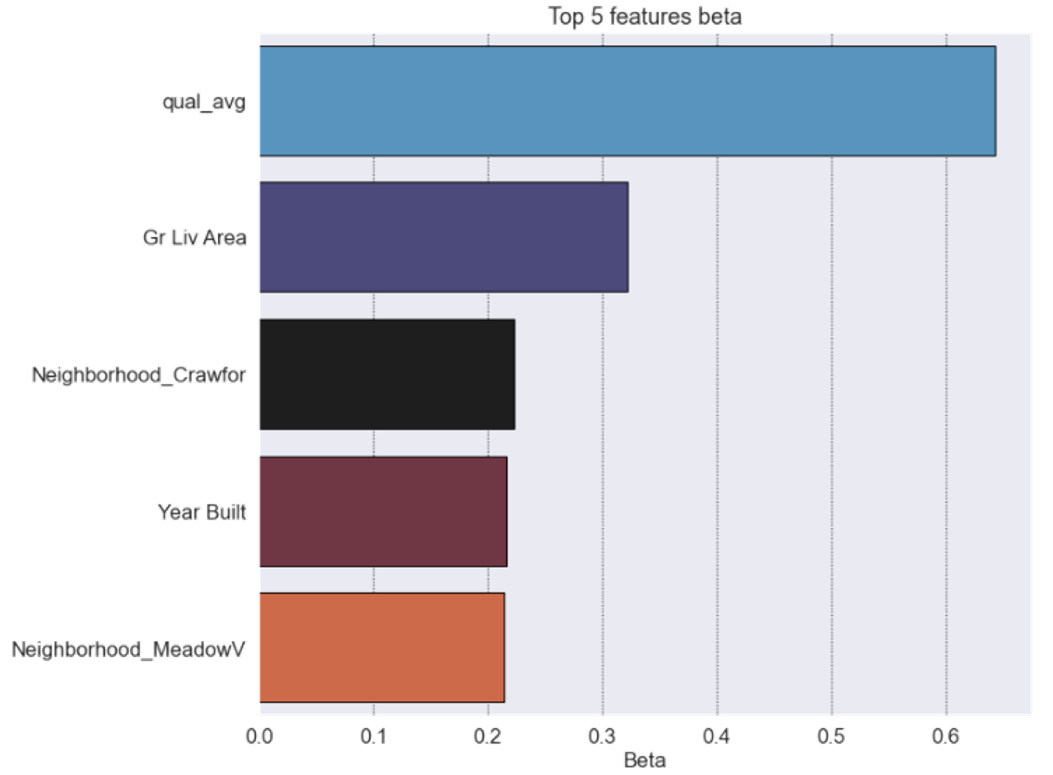
Top 5 Features absolute Beta

Slide 22
04.
Application
Predictor application

Slide 23
Sale price $226631.25 (Predicted)
Overall material and finish quality | 7 | Neighborhood | Collg Cr
Exterior material quality | 4 | Overall condition rating | 5
Above Ground living area (Sq ft) | 1823 | Lot size (Sq ft) | 12192
Kitchen quality | 4 | Size of garage in car capacity | 2
Screen porch area (Sq ft) | 0 | Fireplace quality | 0
Original construction date | 2000 | Basement finished area (Sq ft) | 663
Proximity to main road or railroad | 3 | Home functionality rating | 7
Total basement area (Sq ft) | 928 | Height of basement | 4

Slide 24
Limitations of the Predictor
Predictor is applicable only to the Ames, Iowa housing sale prices.
Data collected more than 10 years old.
Higher sale prices predictions show more variance due to insufficient training data for higher sale prices.
Predictions are limited to the features given at the point of time.

Slide 25
05.
Conclusion
Summary and recommendations

Slide 26
Conclusion
1
Increased accuracy but would need to consider other factors to generalise to other markets
(eg. Government policy - Singapore government’s revision of additional buyer stamp duty in December 2021 as part of cooling measures)
2
Narrowed down the features from 82 to 16

Slide 27
Recommendations
1
Collect more recent data
2
Include features from external sources
(e.g., timestamp related to sale, mortgage interest rates at time of sale, Iowa population growth, employment figures)
Create an app for a seamless experience!

Slide 28

Questions?

Slide 29

Thank you!

